Slide 1

Computer System Servicing

Slide 2
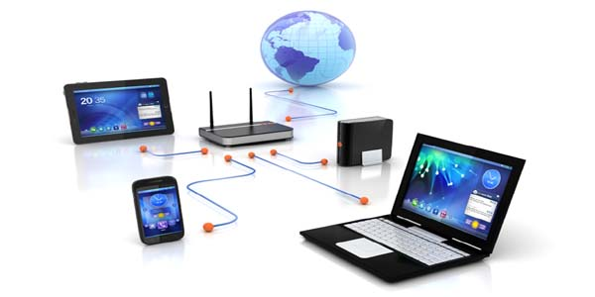
Computer Network
A Computer Network is a group of two or more computers connected to each other for sharing resources and information

Slide 3
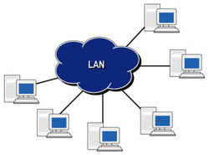
Types of Computer Network
LAN (Local Area Network)
LAN is a computer network which distances over a small geographical area such as home, building, office, school etc.

Slide 4
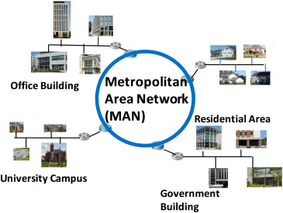
Types of Computer Network
2. MAN (Metropolitan Area Network)
MAN is a computer network which connects two or more LAN Network in a city or town.

Slide 5
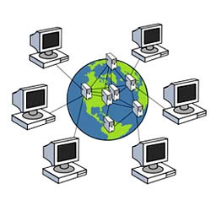
Types of Computer Network
3. WAN (Wide Area Network)
WAN is a computer network which spans over a larger geographical area such as country or the world.

Slide 6
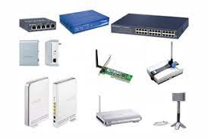
Network Devices
Devices are required for communication and interaction between hardware on a computer network.

Slide 7
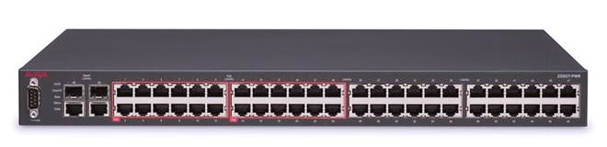
Network Devices
HUB/Switch HUB
A device that filters and forwards packets between LAN segments.

Slide 8
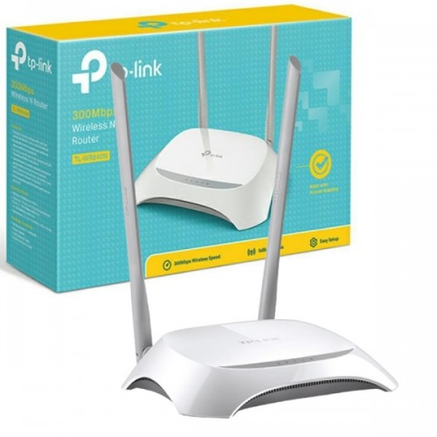
Network Devices
2. Router
A device that forwards data packets along networks. A router is connected to at least two networks and its internet service provider network.

Slide 9
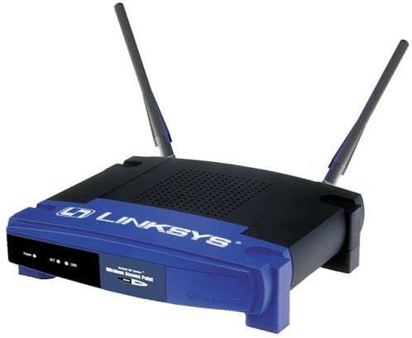
Network Devices
3. Wireless Access Point (WAP)
A device that allows other Wi-Fi devices to connect to a wired network

Slide 10
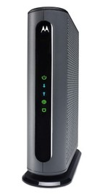
Network Devices
4. Modem (Modulation Demodulation)
A device that converts data into a format suitable for transmission medium so that it can be transmitted from one computer to another.

Slide 11
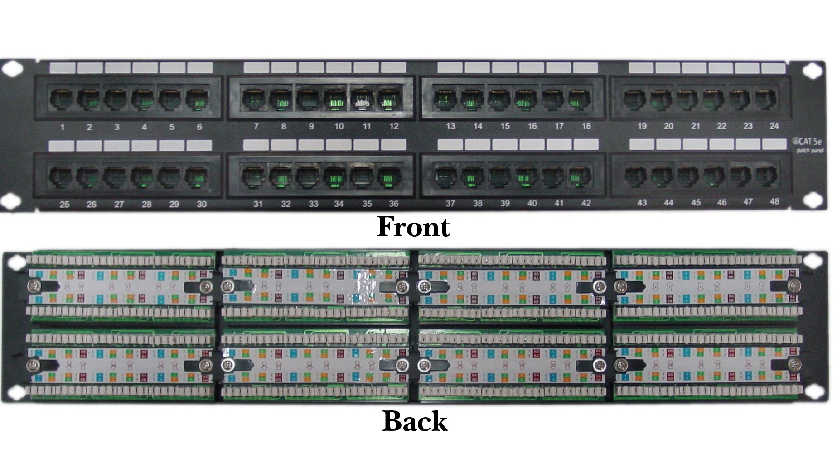
Network Devices
5. Patch Panel
A bundle of multiple network ports together to connect incoming and outgoing lines including those for local area networks, electronic, electrical system and communications.

Slide 12
FORMATIVE ASSESSMENT
Direction: Differentiate HUB from Switch HUB

Slide 13
Practical Application of the acquired
Learning Competencies

Slide 14

GENERALIZATION

Slide 15
THANK YOU!!!

